Slide 1
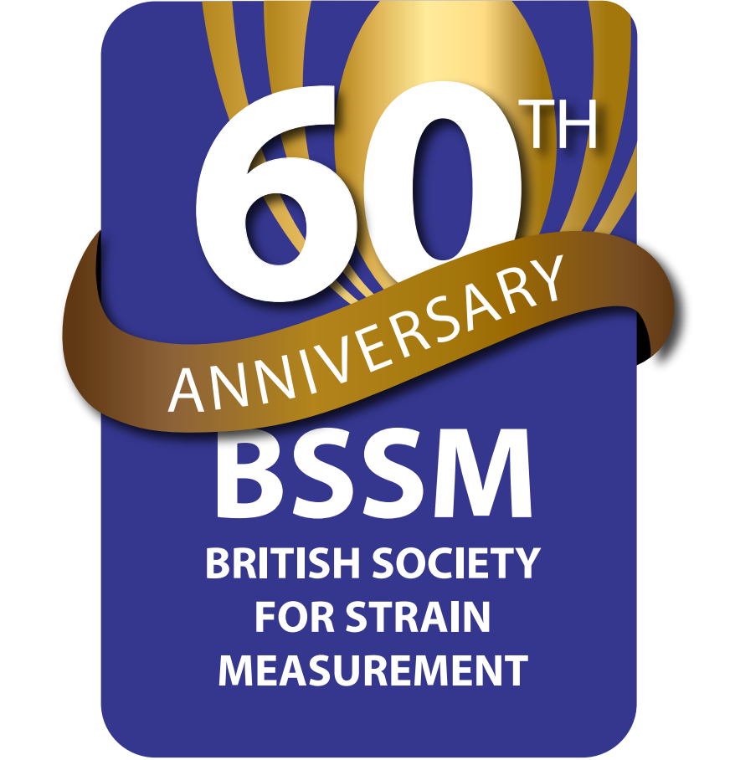
Welcome and Celebrating 60 Years of the BSSM
Dr Hari Arora
Biomedical Engineering, Swansea University
Chair of the British Society for Strain Measurement (BSSM)
BSSM 60th Anniversary Showcase (2024)

Slide 2
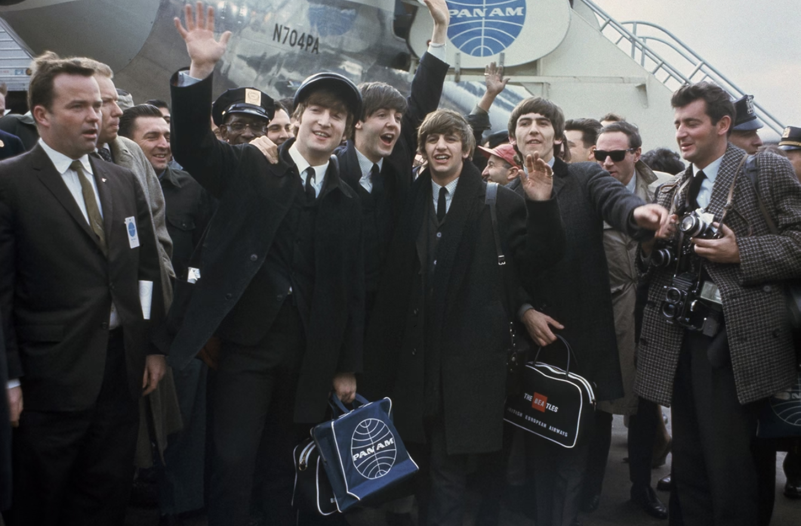
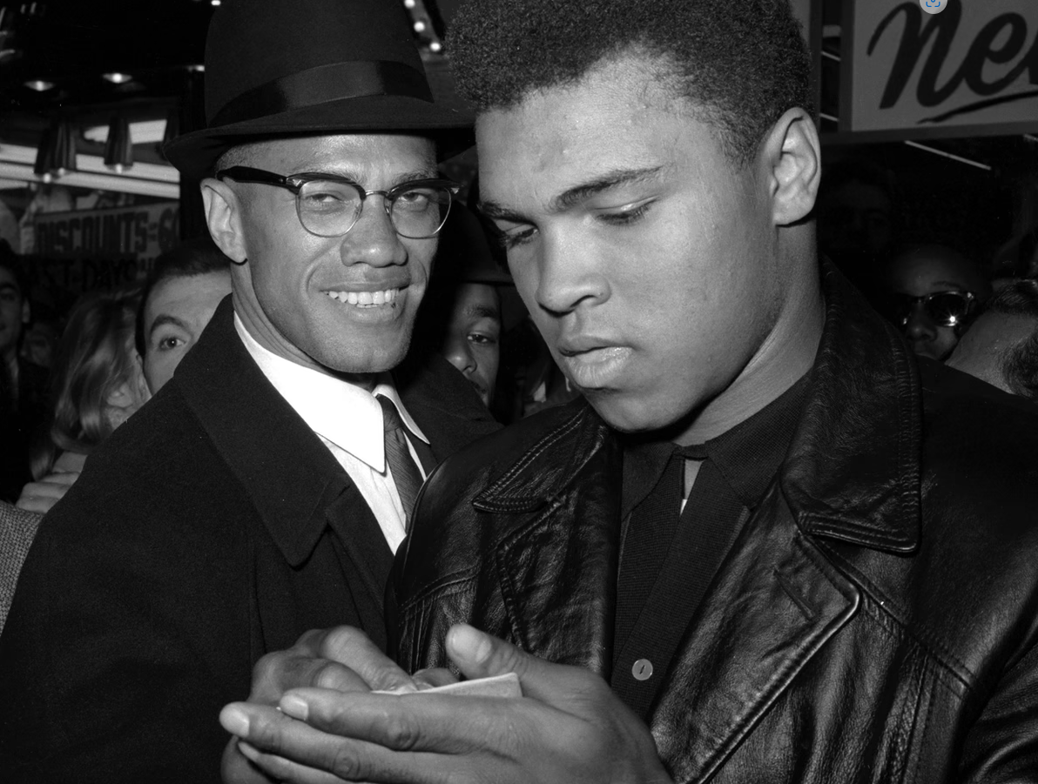
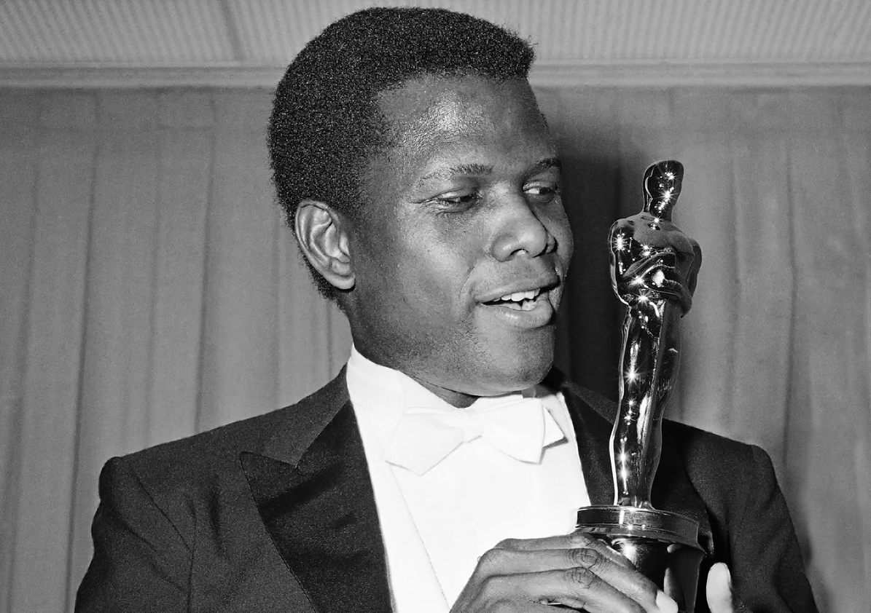
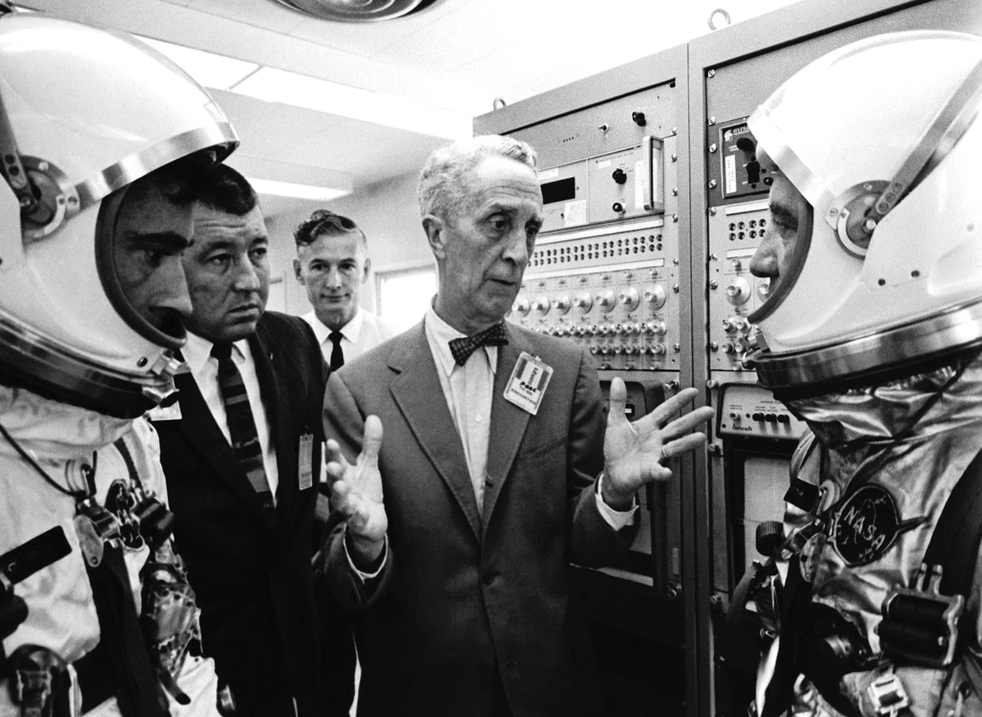
What happened in 1964?
Lots of leaders in their respective fields were striving towards and achieving world-wide success
Meanwhile...
Strain Gauge Division of Saunders-Roe Ltd. had been holding regular conferences regarding strain measurement.
In May 1964 an overwhelmingly positive vote for establishing a society for strain measurement was passed and an initial committee formed
BSSM formally was established in September 1964
Geoff Chalmers, President of BSSM
AP Photo

Slide 3
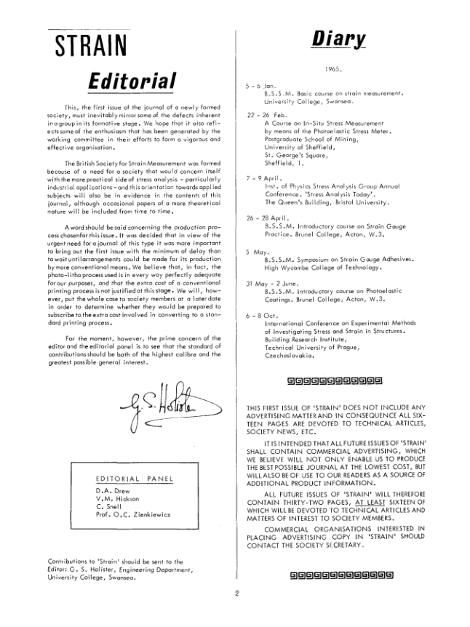
BSSM’s Journal - Strain
First issue published Jan 1965
Topics: Strain Gauges and Photoelasticity
Editor G.S Holister from University College Swansea
Editorial panel included O.C. Zienkiewicz, a leader in computational mechanics
Now we are celebrating the 60th Anniversary with a Special Issue in Strain
Editorial, Strain, Volume 1, Issue 1 (1965)

Slide 4
BSSM’s Mission
A non-profit making scientific, educational and promotional organisation advancing knowledge of Strain Measurement, Stress Analysis and Experimental Mechanics

Slide 5
Committee and Structure
In September 1964, the British Society for Strain Measurement (BSSM) was formed
BSSM was administered through a National Executive Committee (NEC) until 1984
National Council (NATCO) was then formed as a smaller body than NEC, and allowed more detailed matters to be handled by separate committees, each with its special remit and technical interest.
National Council
Scientific and Technical Committee
Certification Committee
Conference Organising Committee
WebCo
Journal - Strain

Slide 6
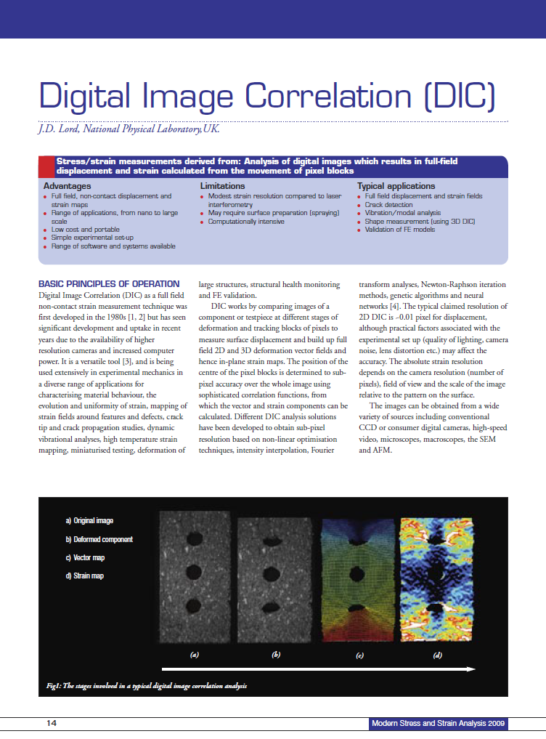
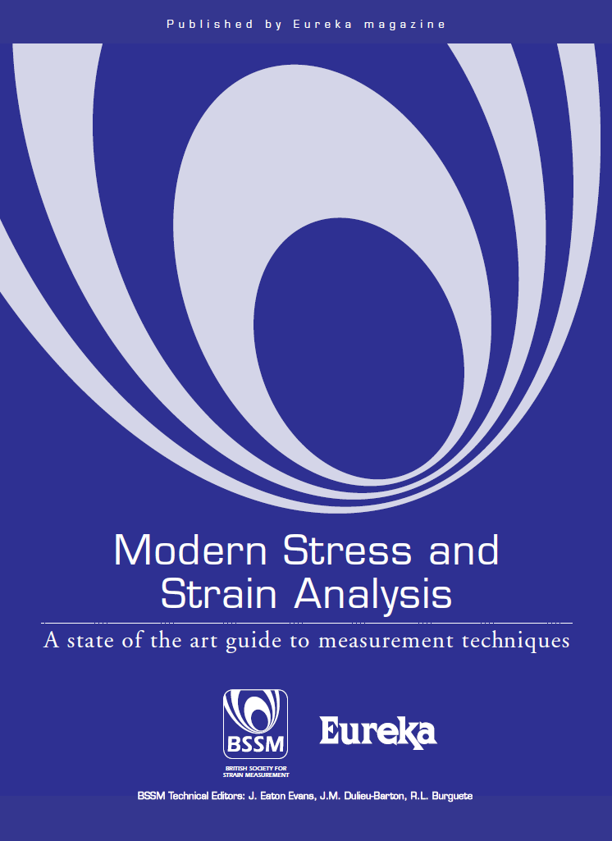
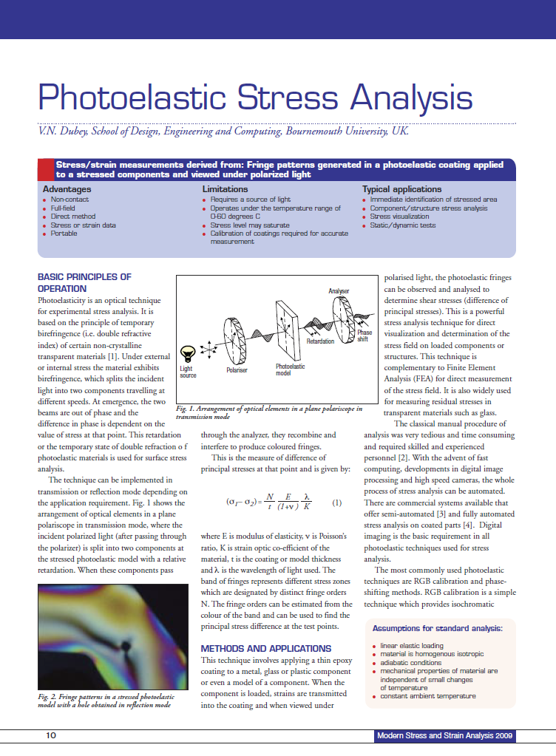
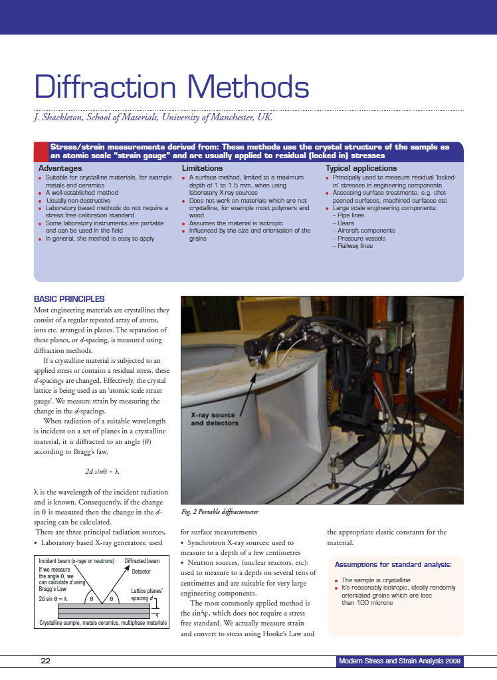
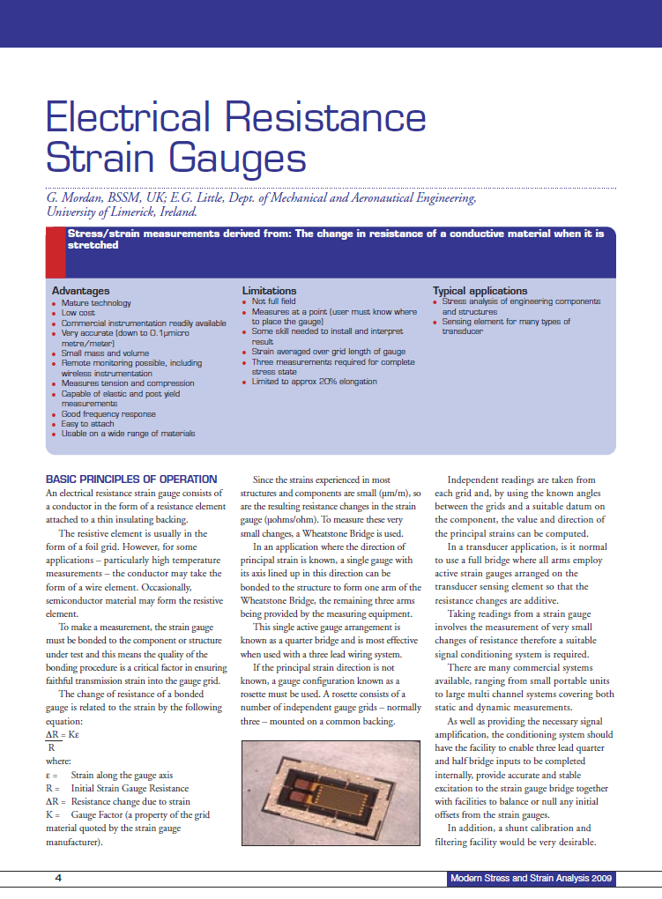
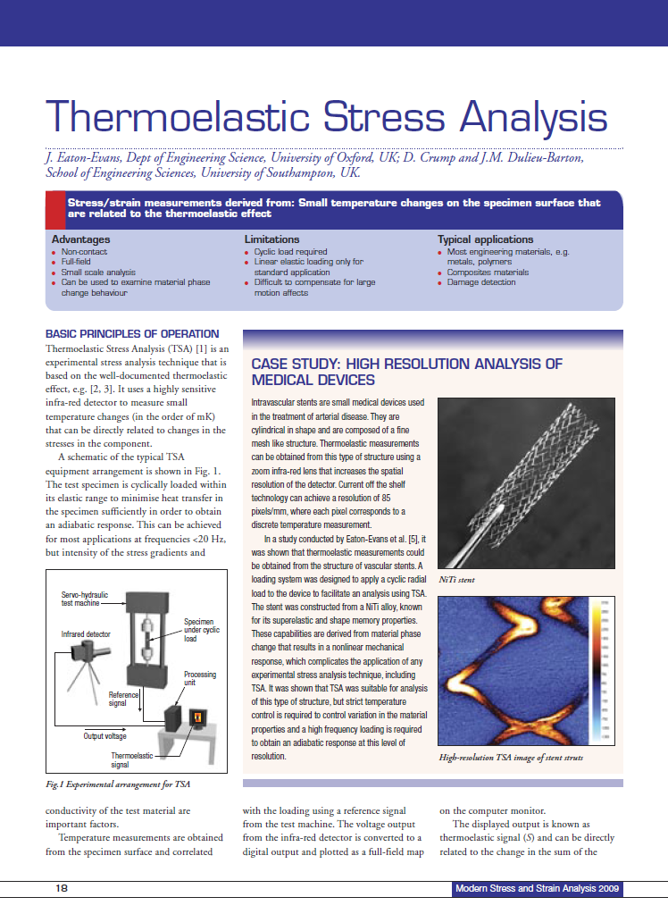
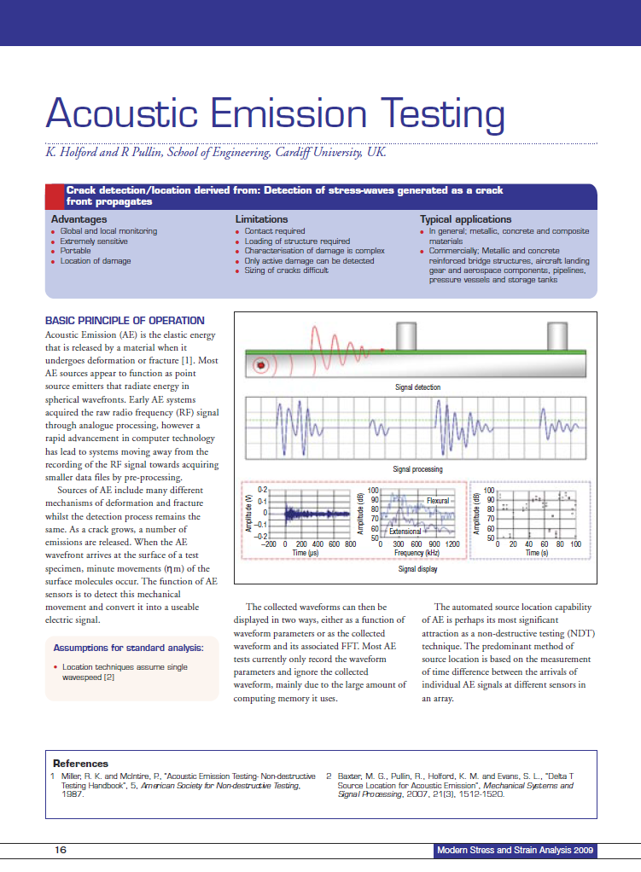
Advancement of Techniques
Started with the strain gauge and developed to cover all techniques in strain measurement, stress analysis and experimental mechanics
Dissemination and Training are important pillars of the society
Members continue to drive new areas, sharing with the community
CerCo Training Courses
Experimental Mechanics Workshop
Specialized Workshops and Events
Publications
Conferences

Slide 7
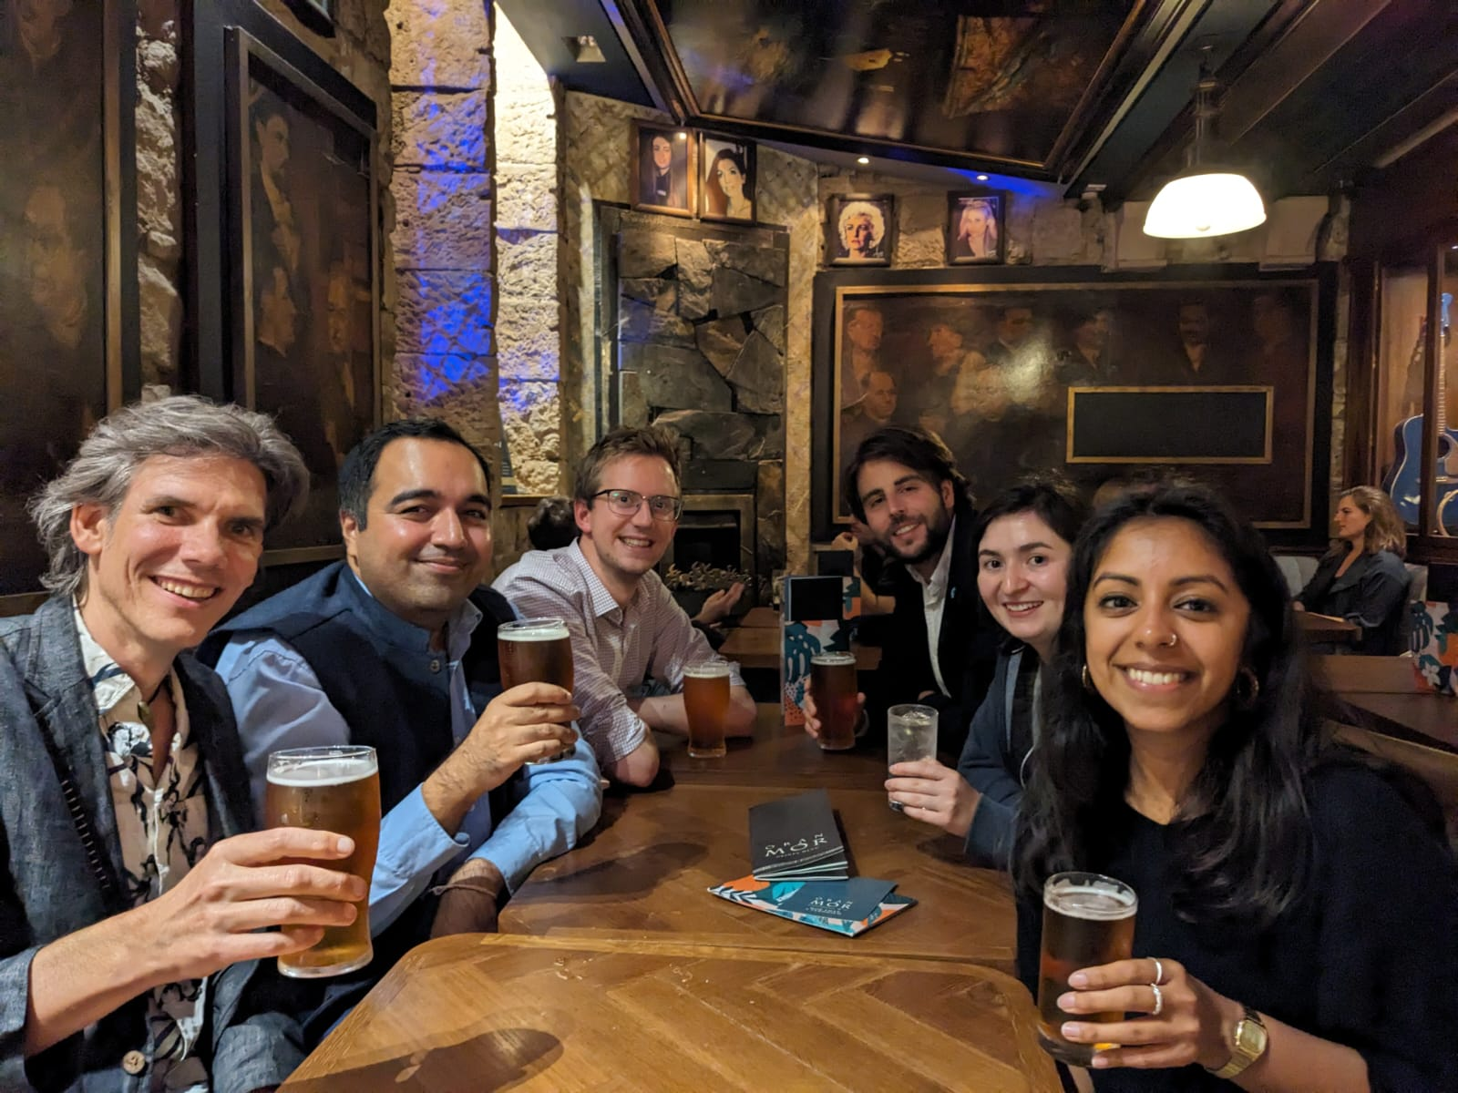
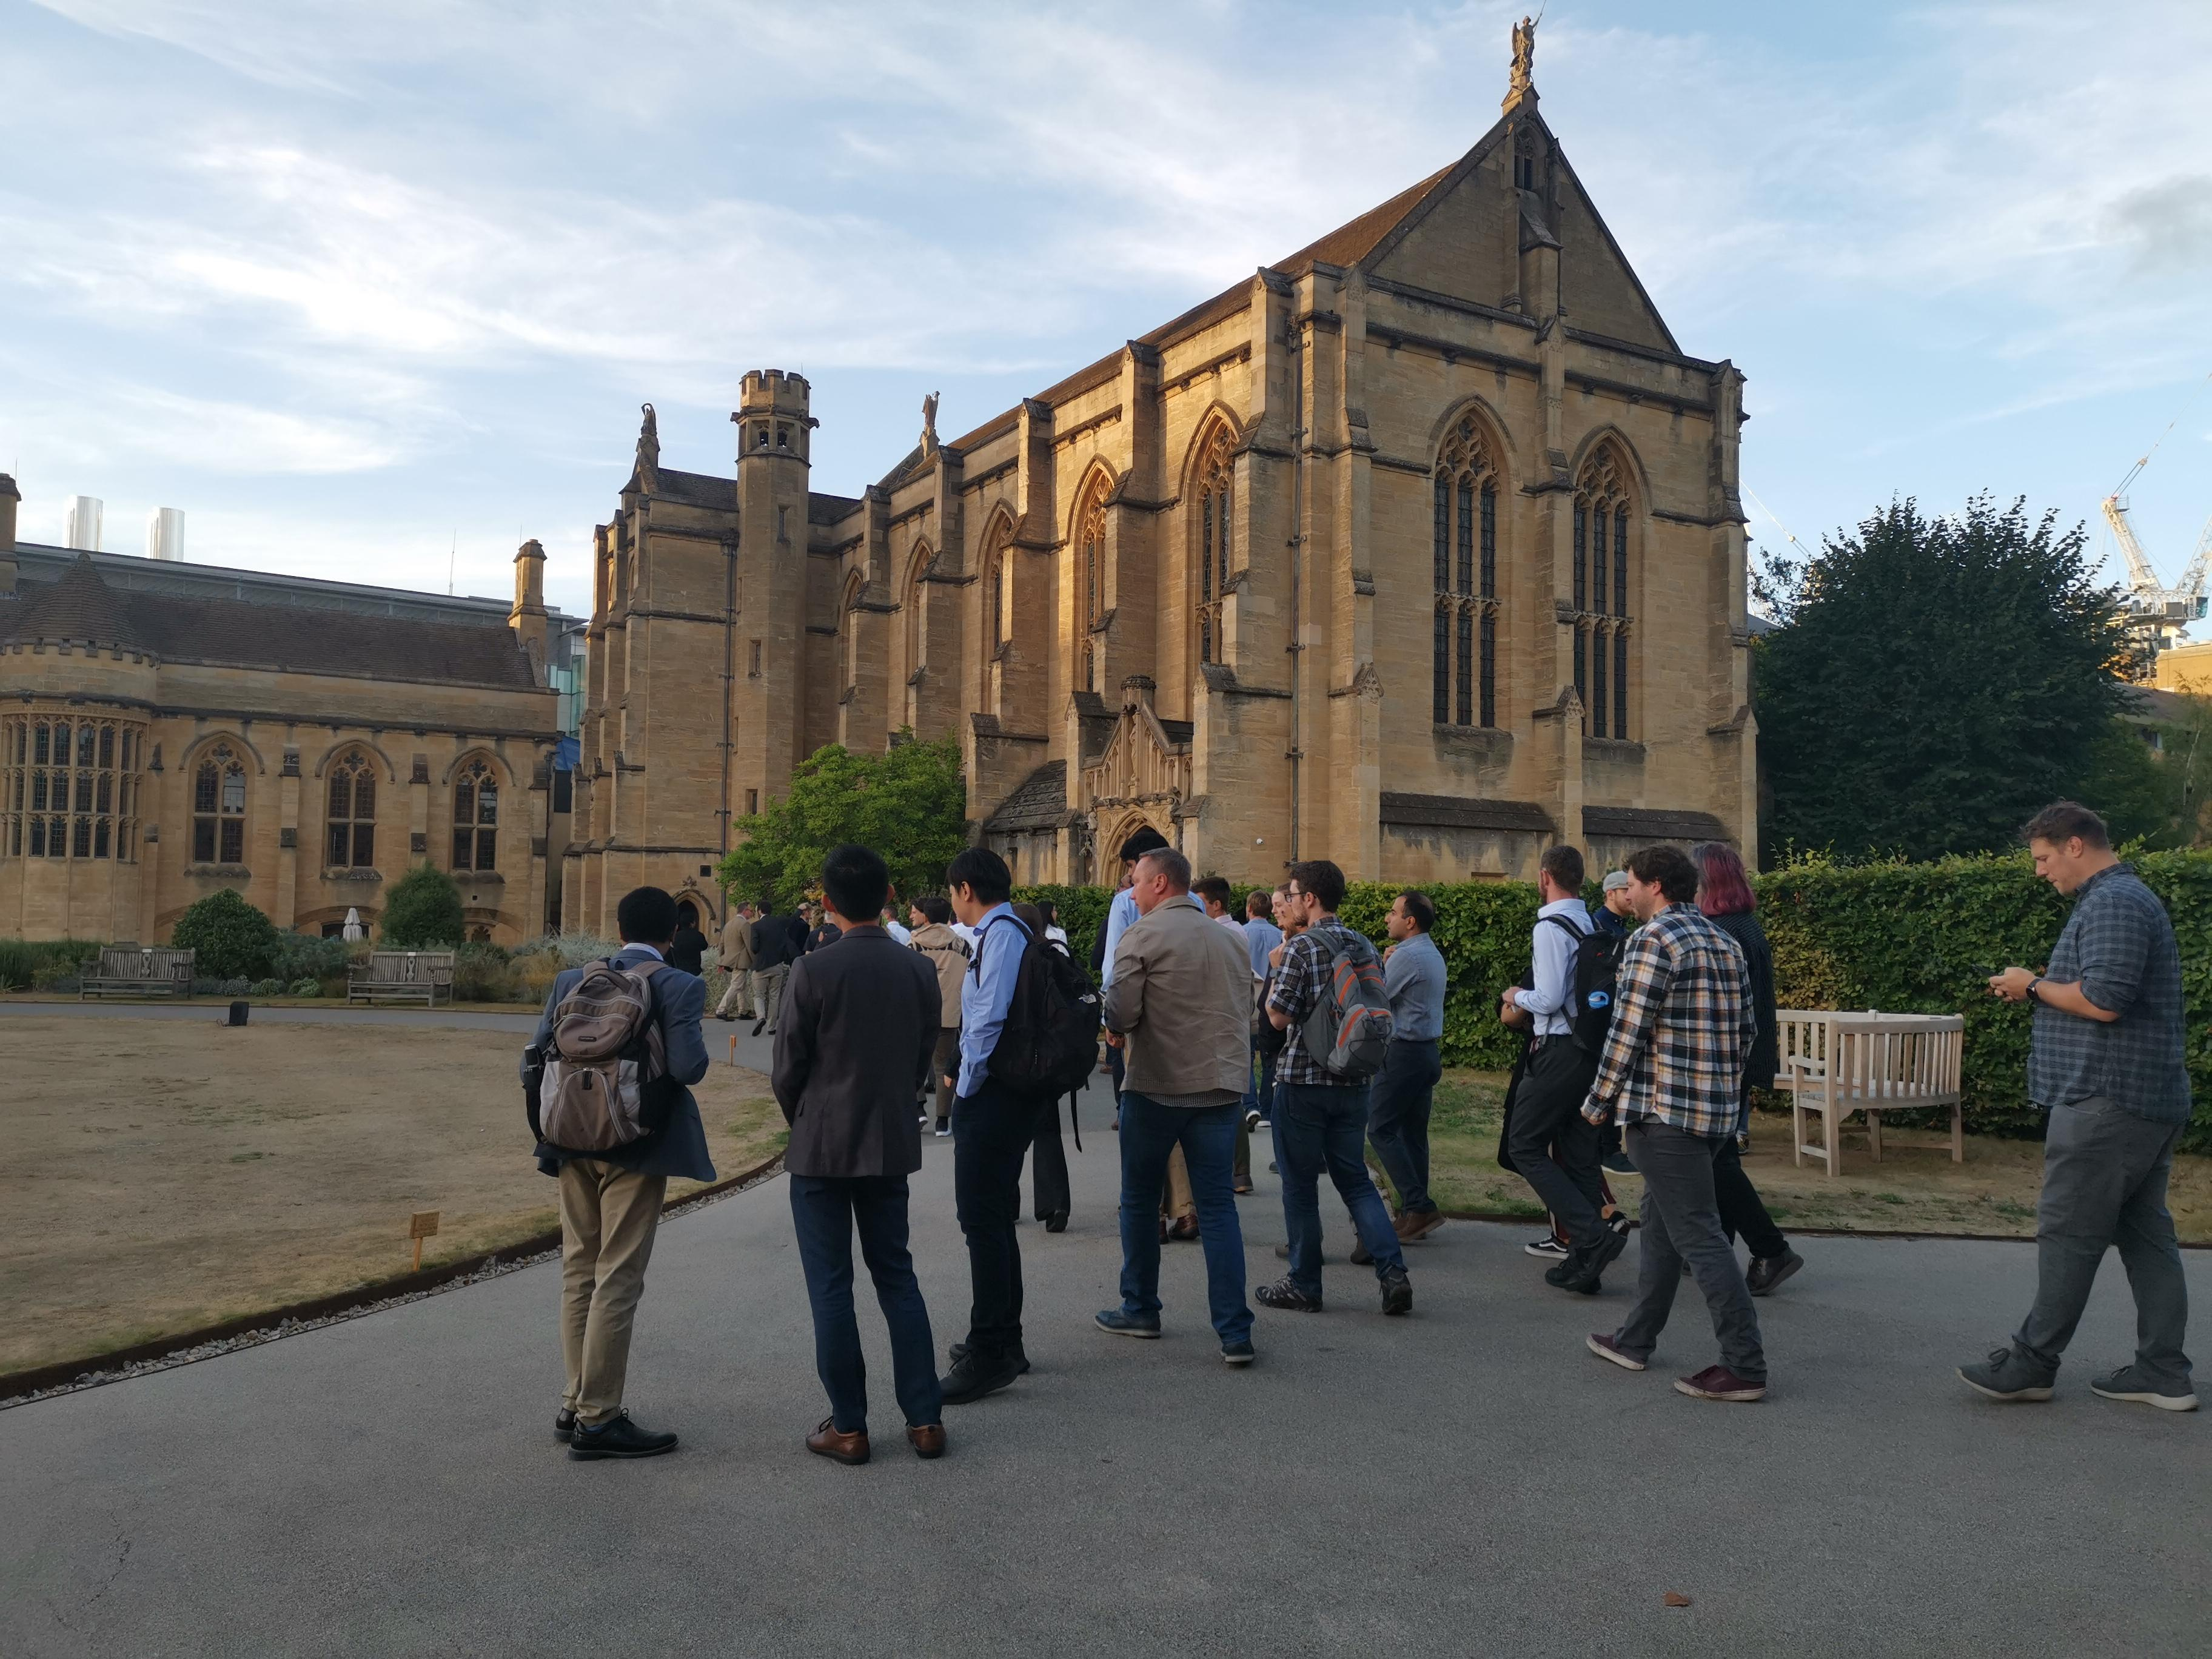
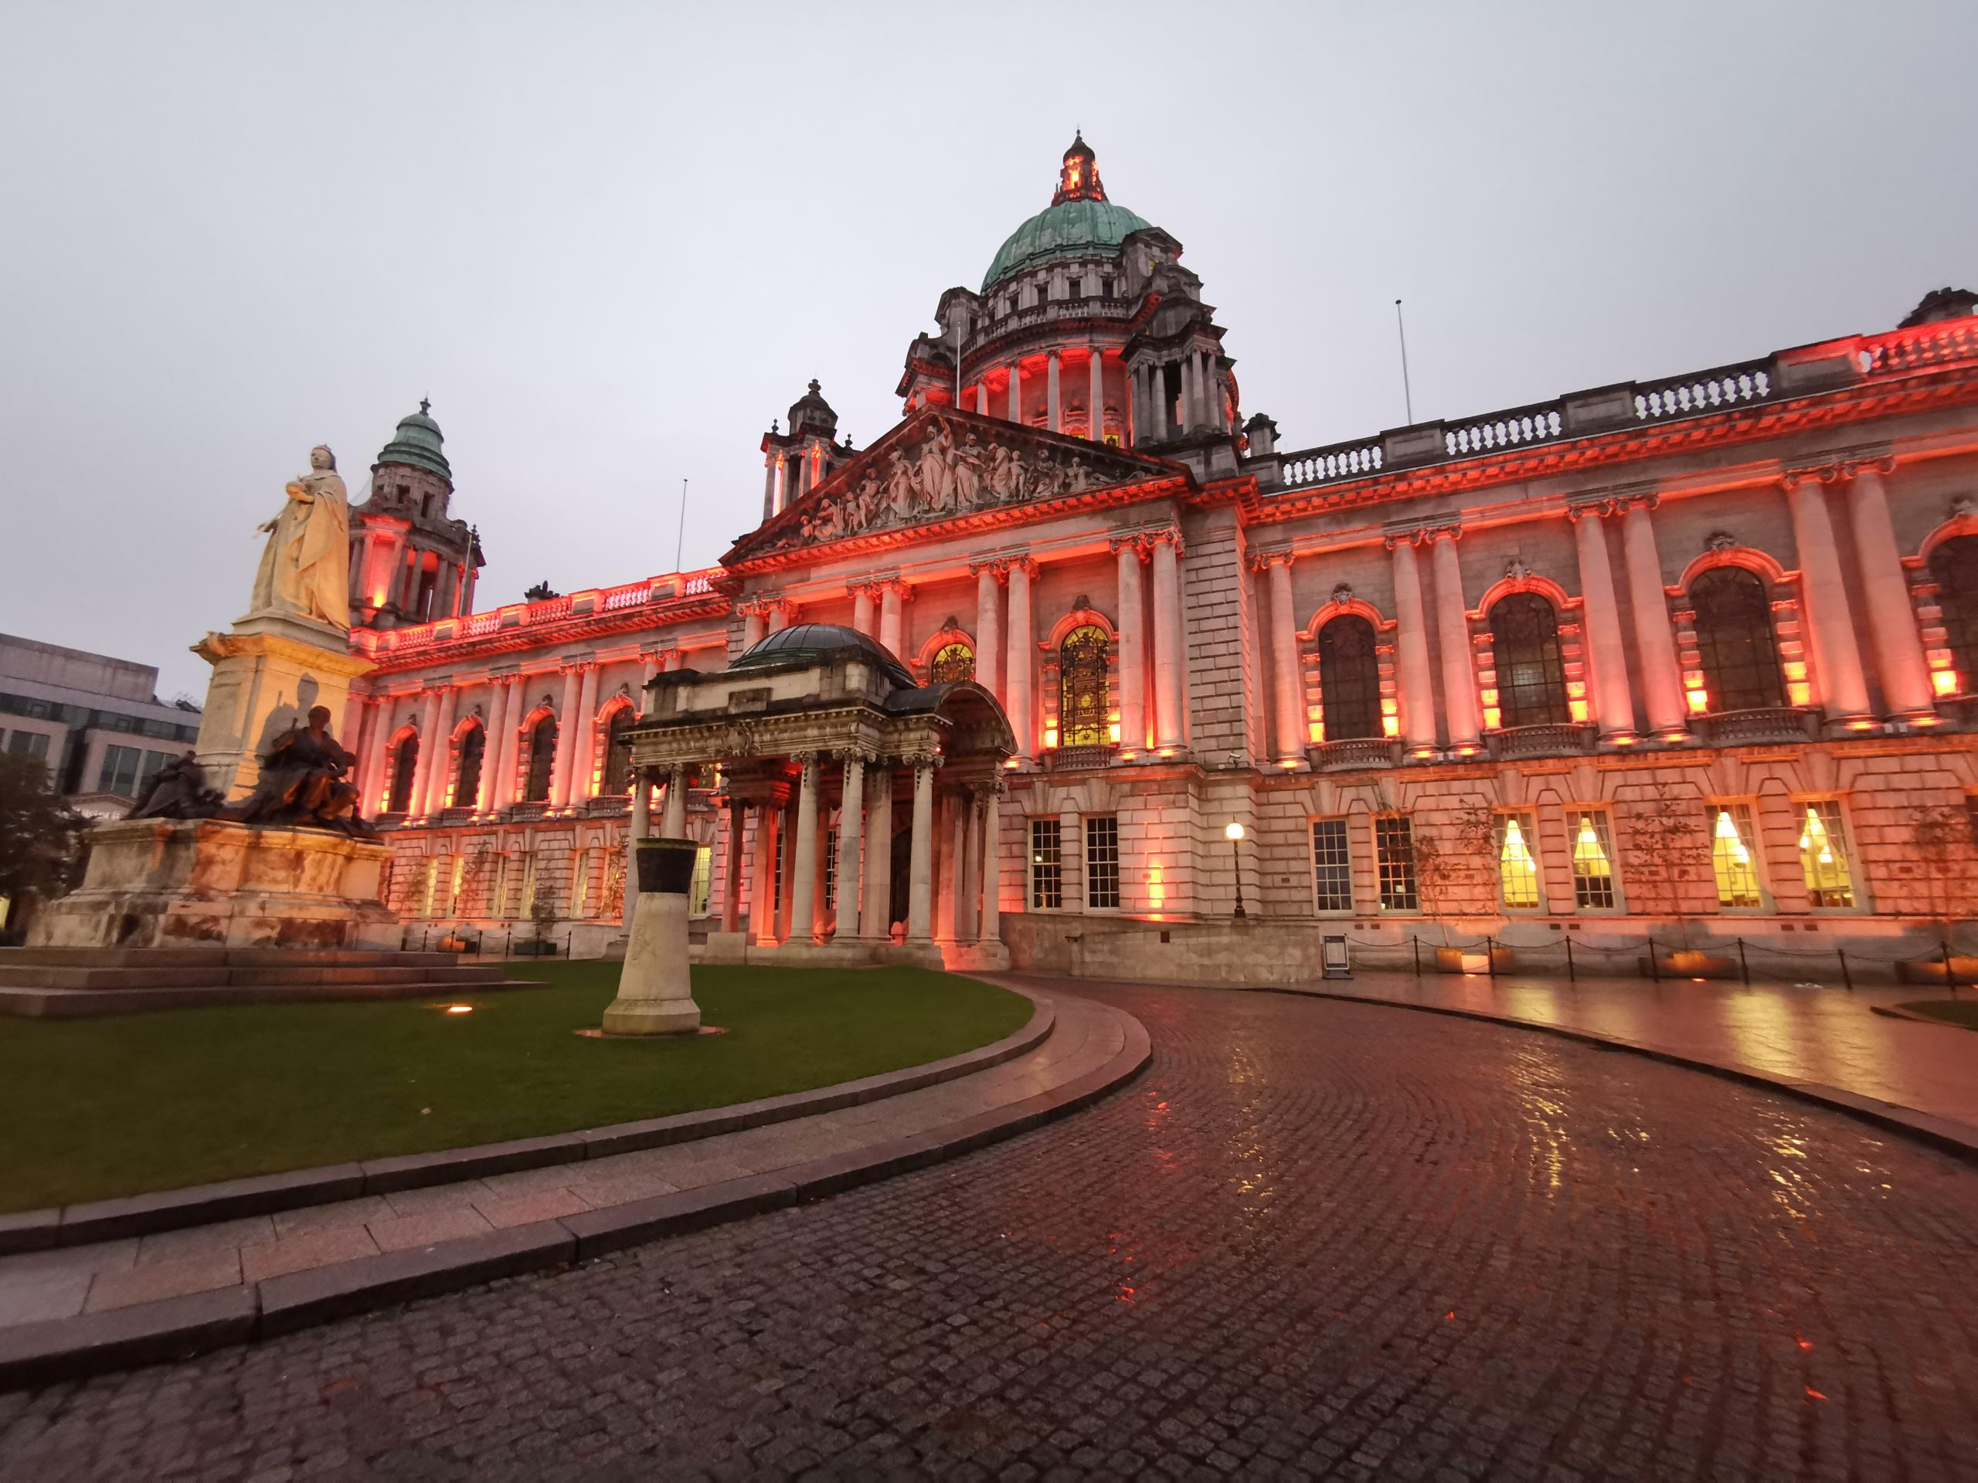
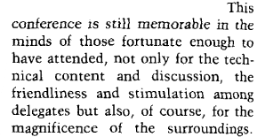
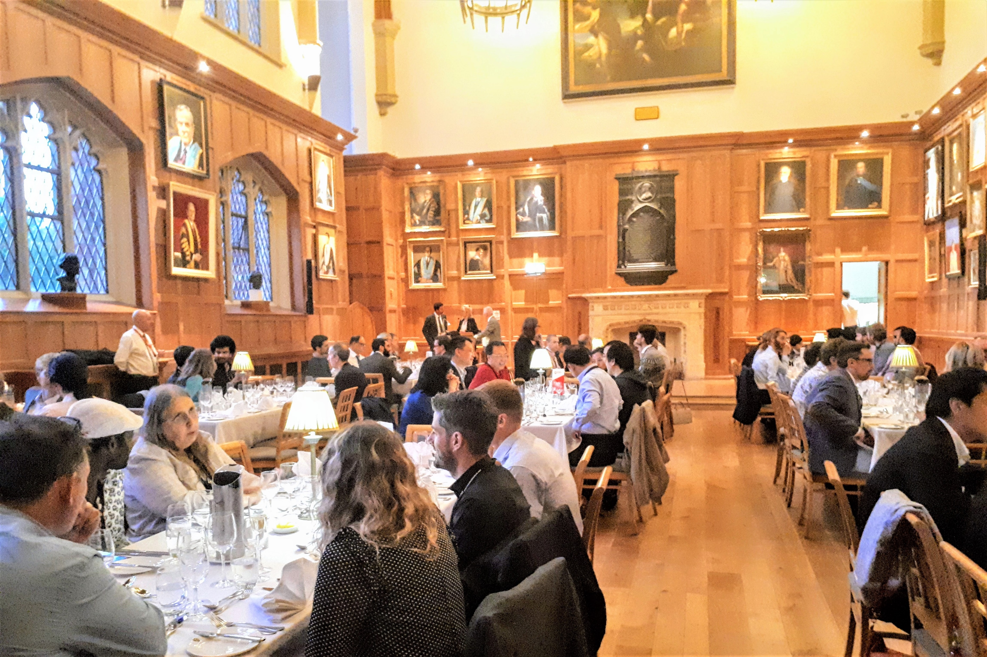
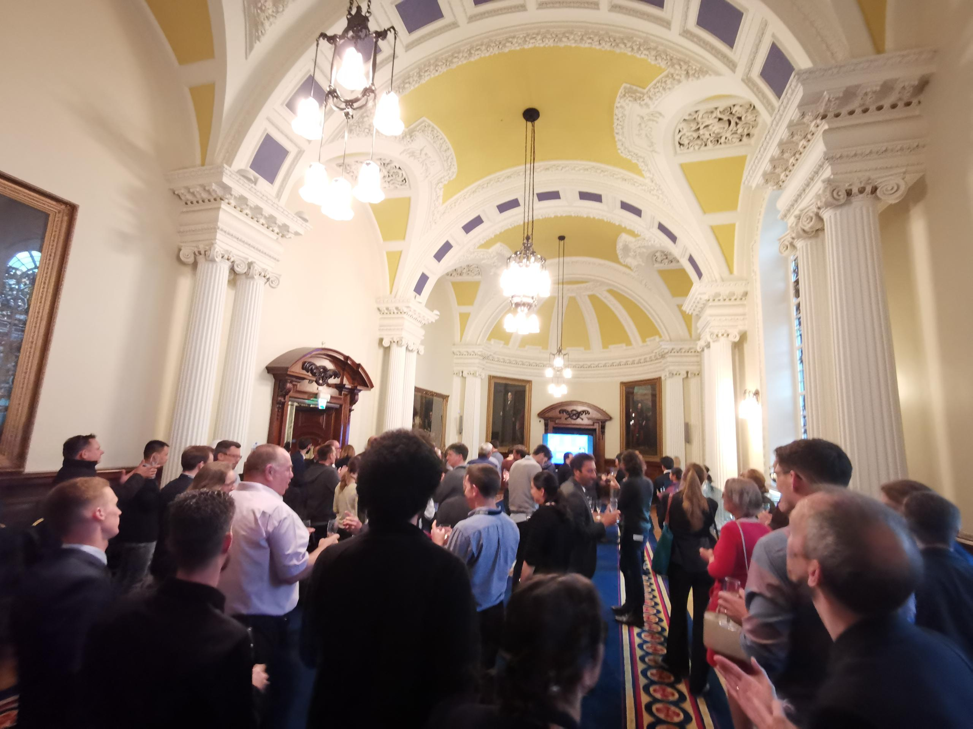
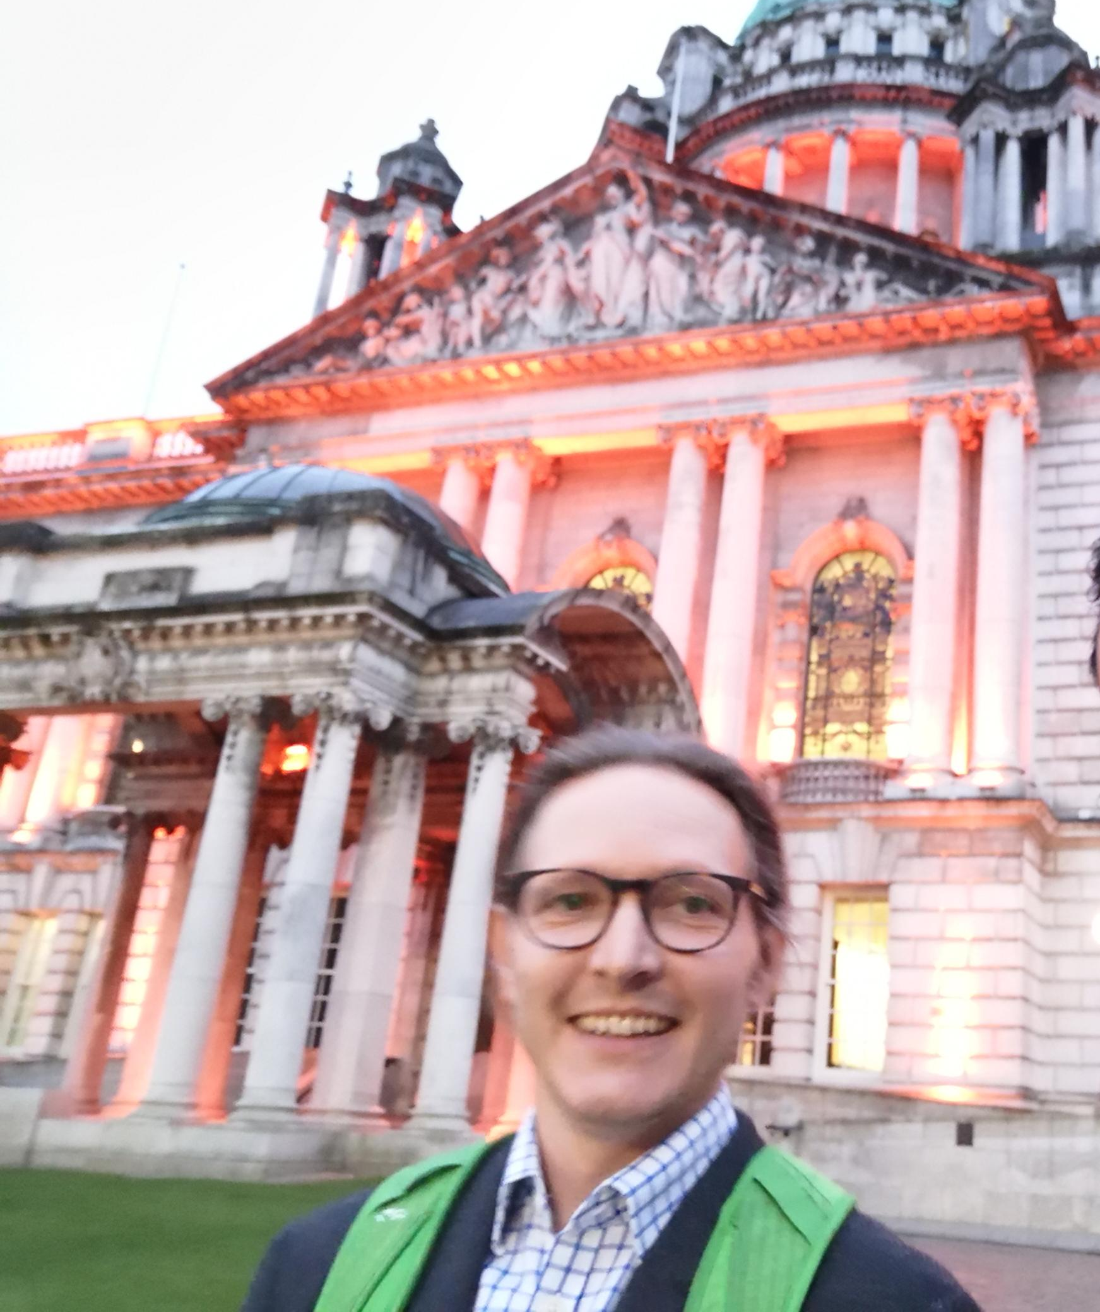
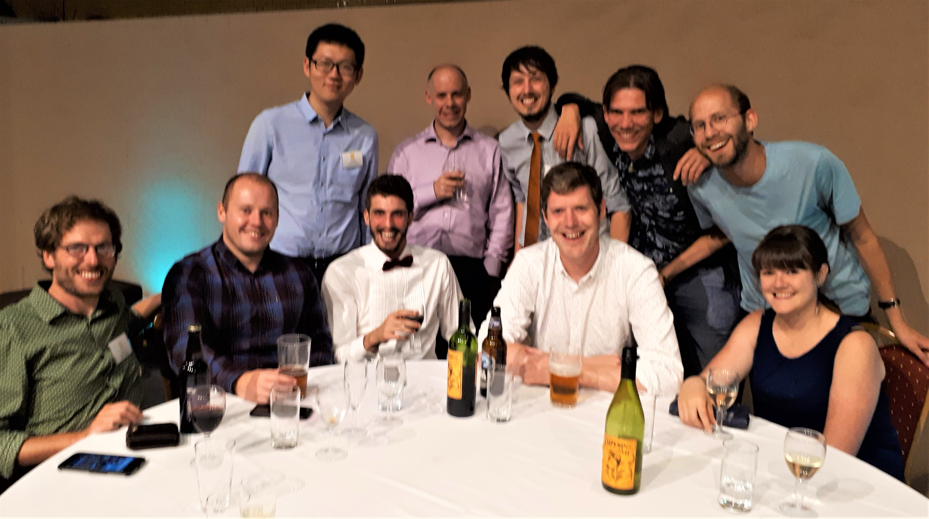
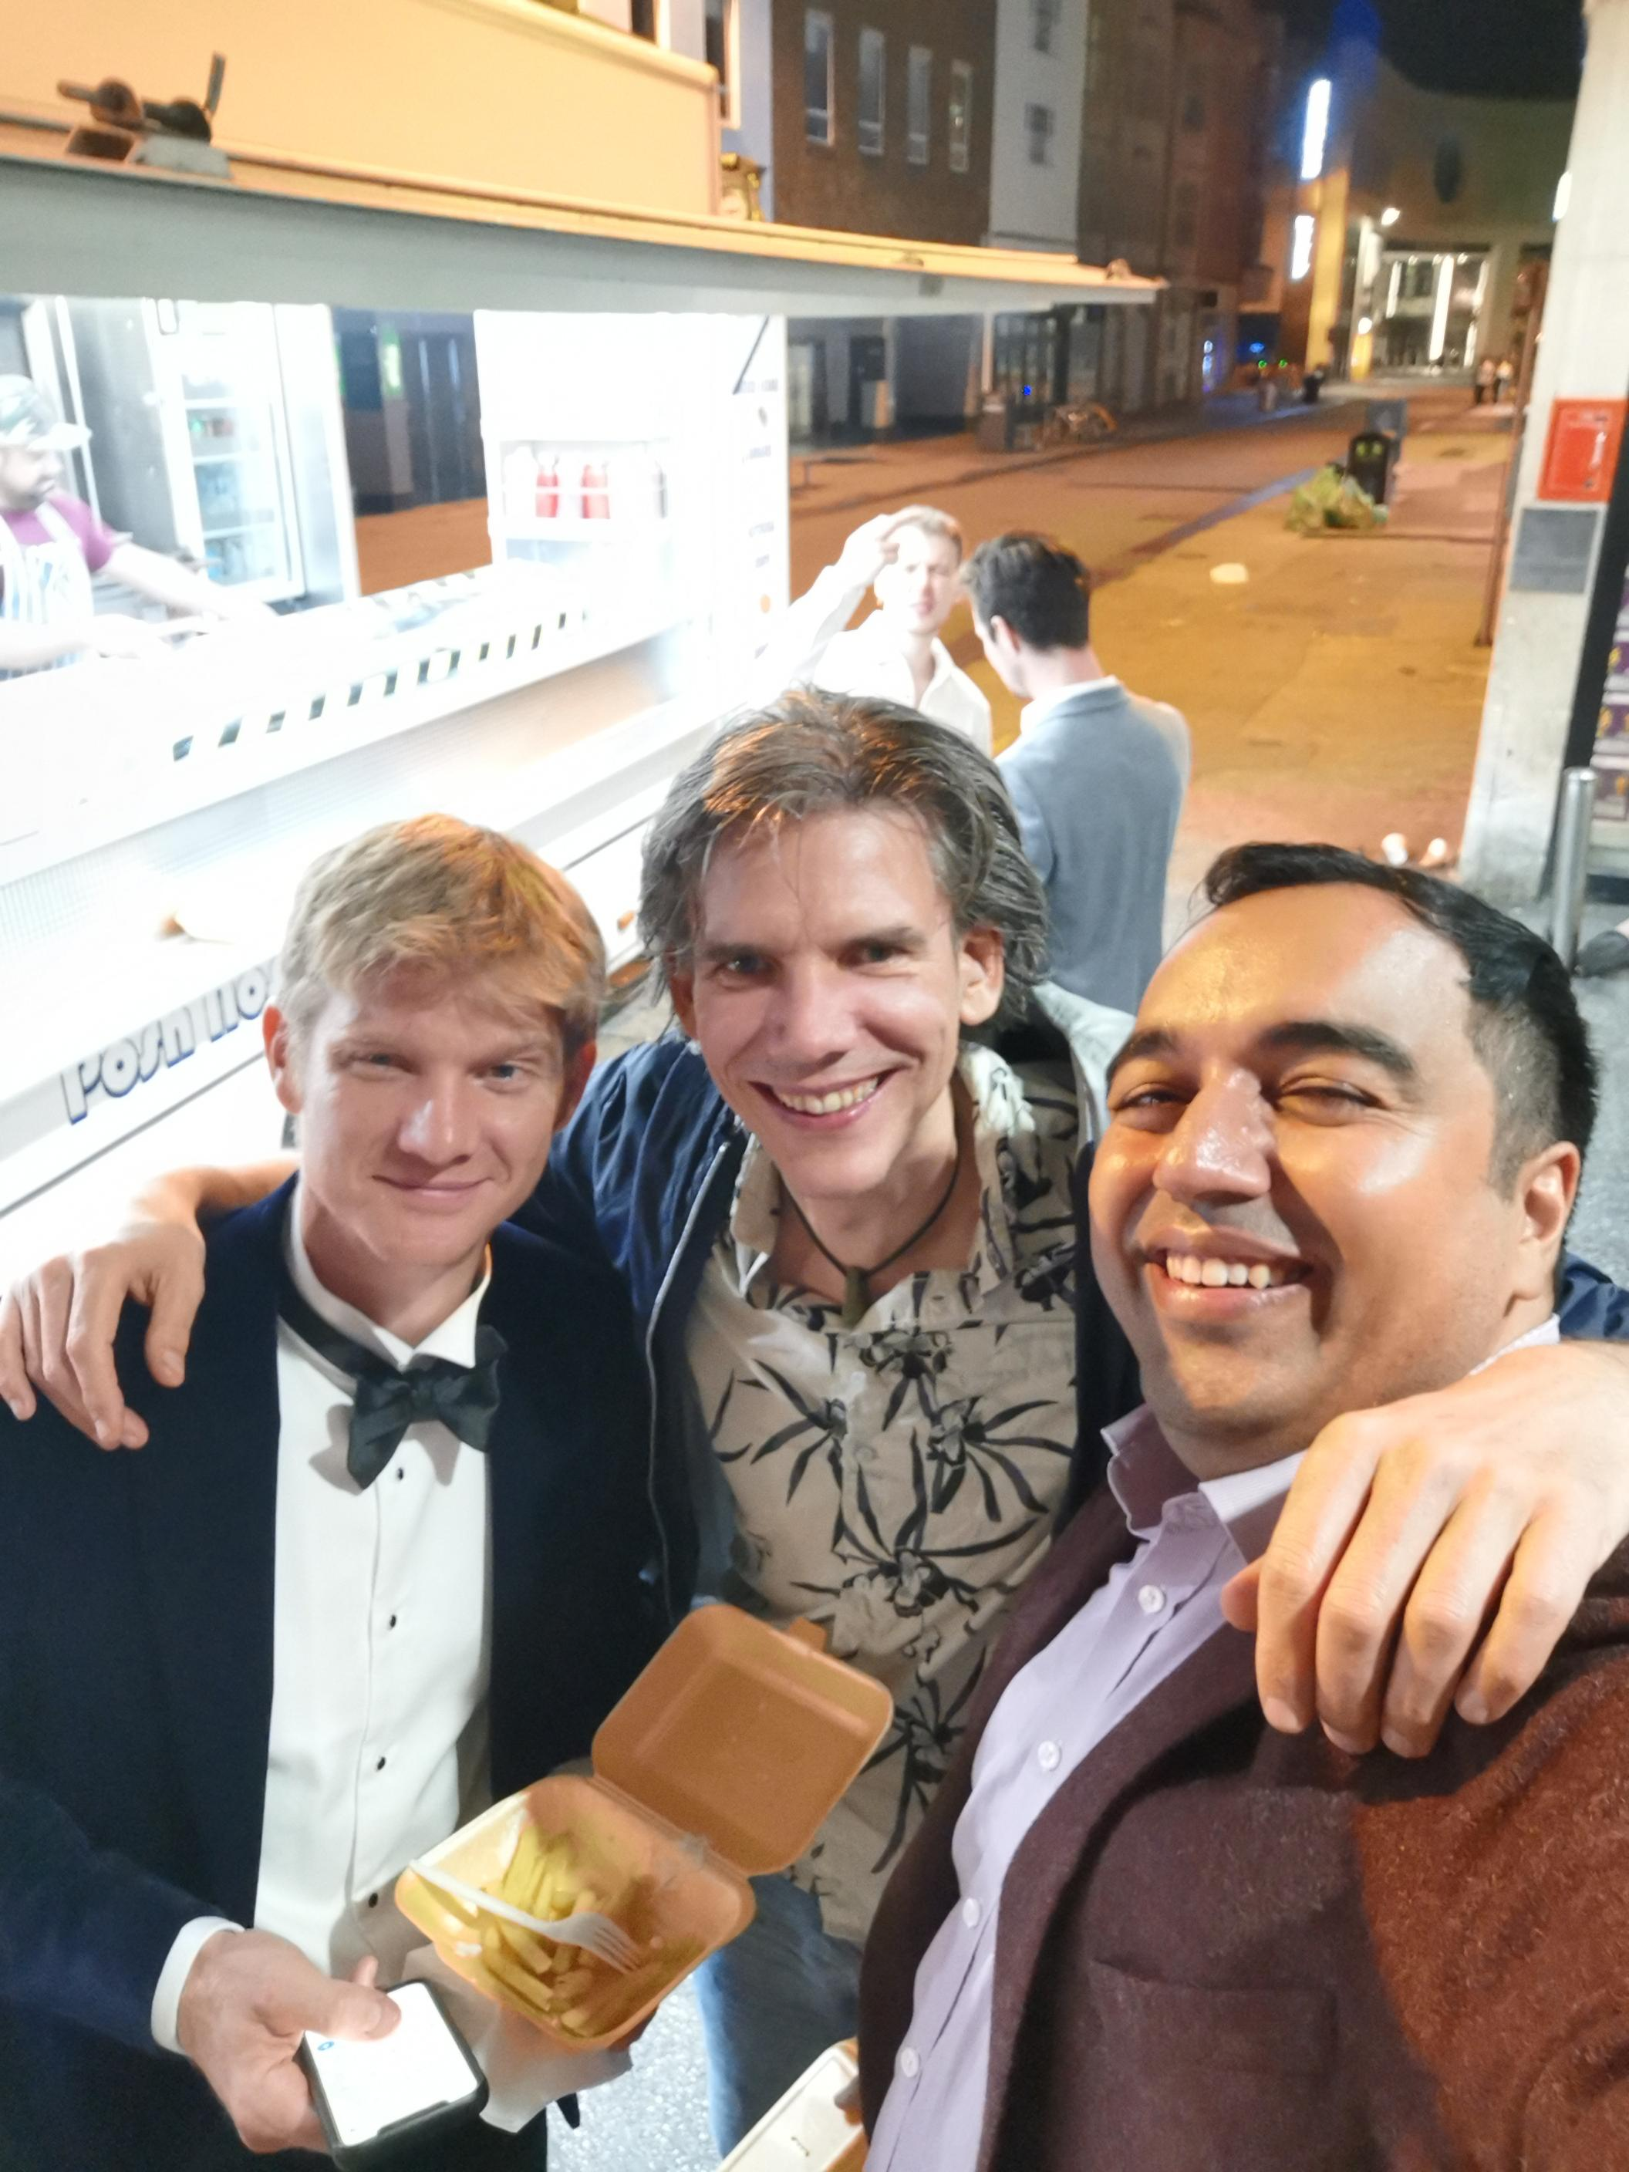
Conferences
Annual conferences been running since the start to share best practice and bring the community of experts together
Commander D. Male chaired the first Annual Conference, Sept 20-21, 1965
It was held amid the elegance and splendor of the Royal Naval College, Greenwich, situated on the south bank of the Thames on the site of the palace in which Queen Elizabeth the First was born.
This year we celebrated by the water in Liverpool, next year we will be back in London
Conference Organising Committee

Slide 8
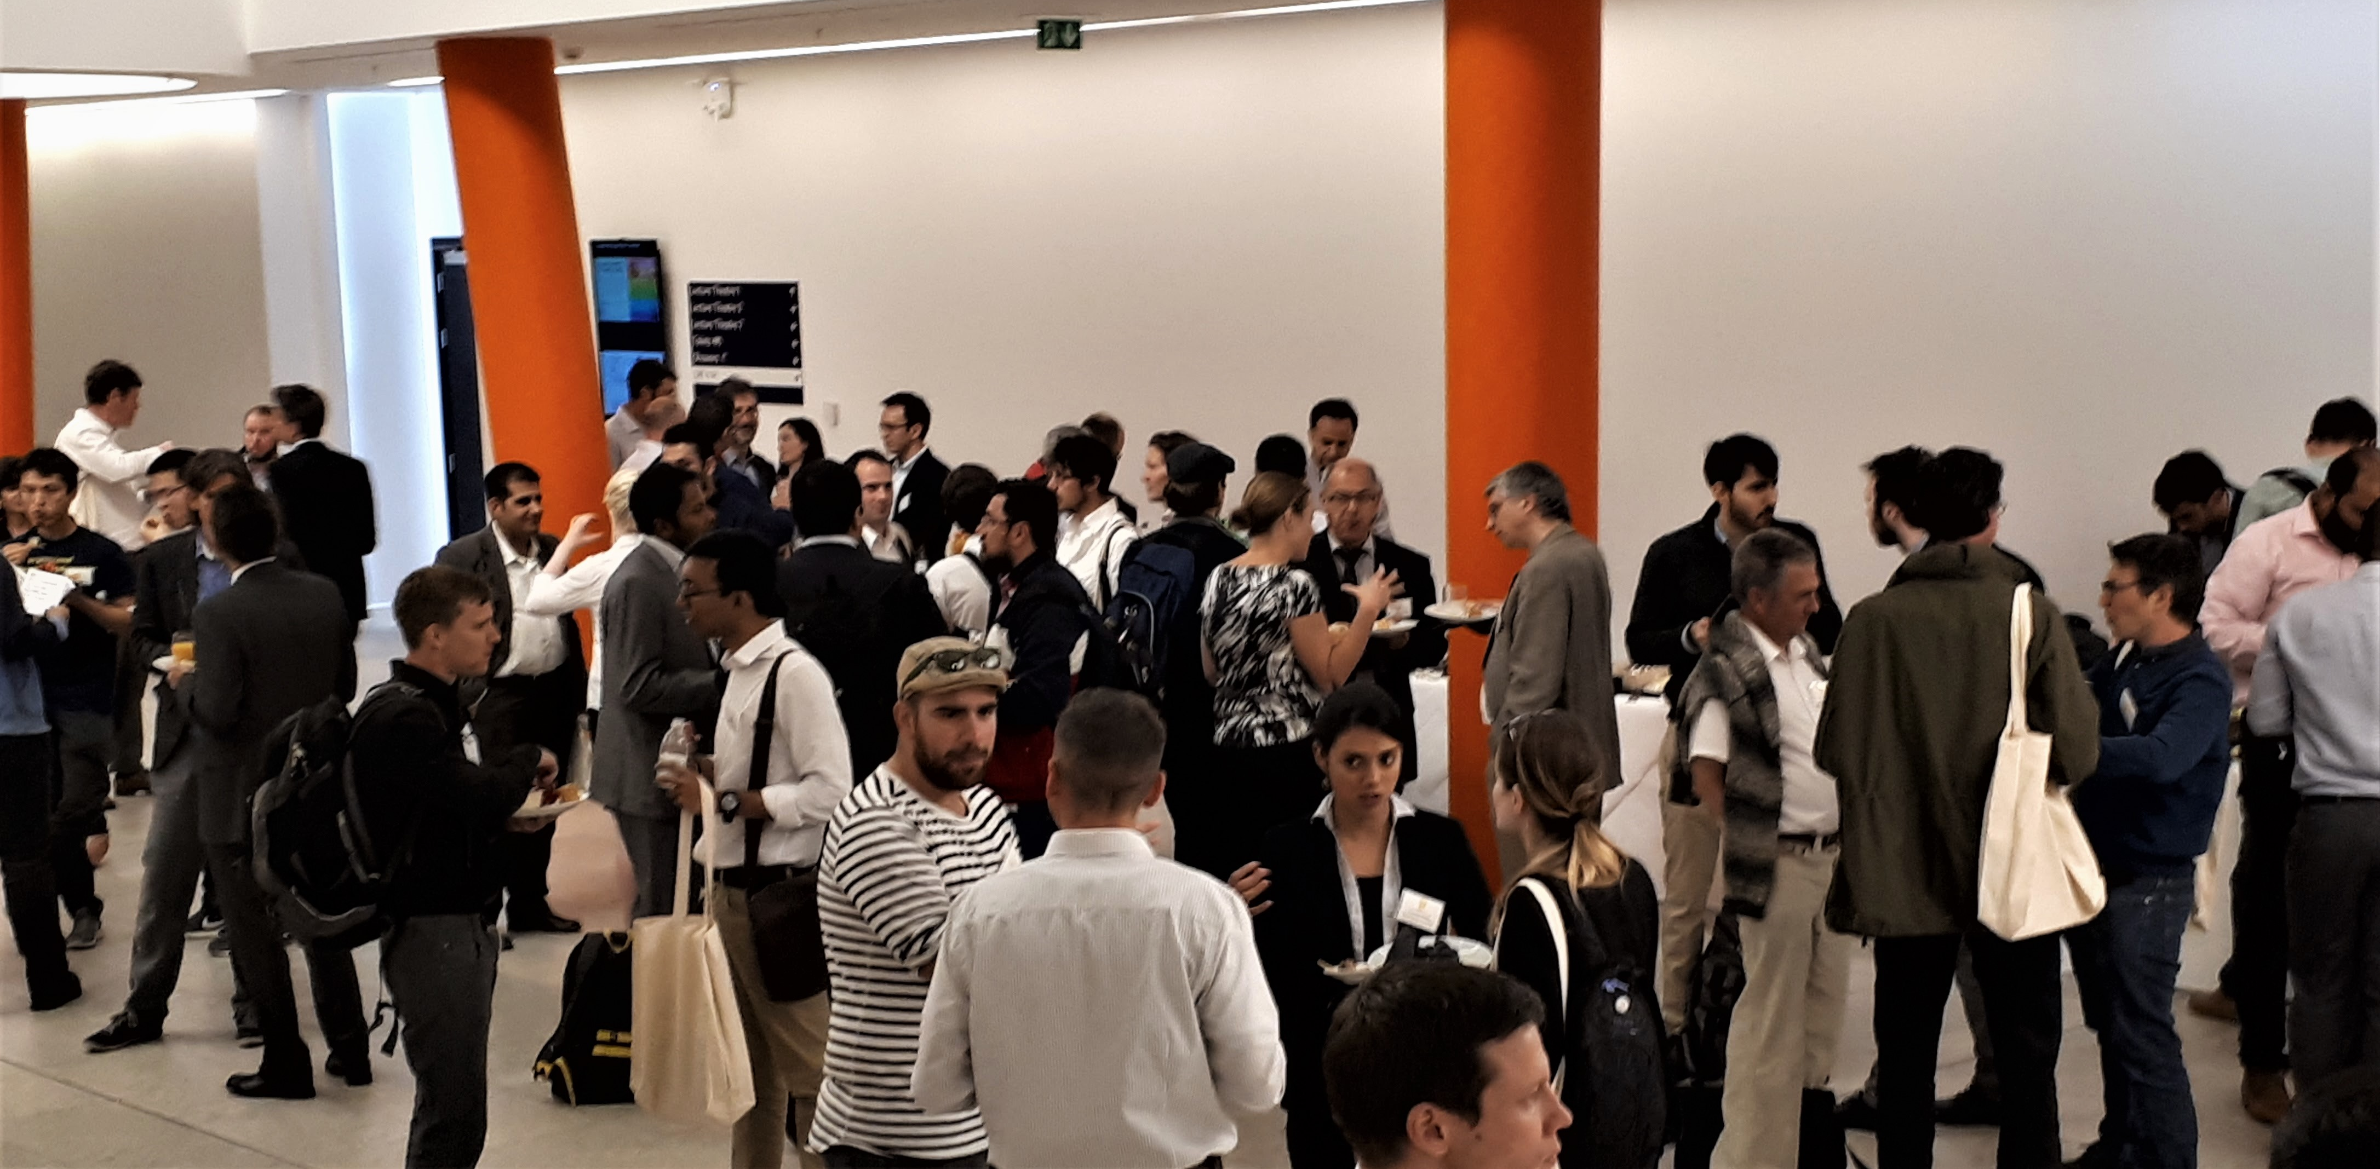
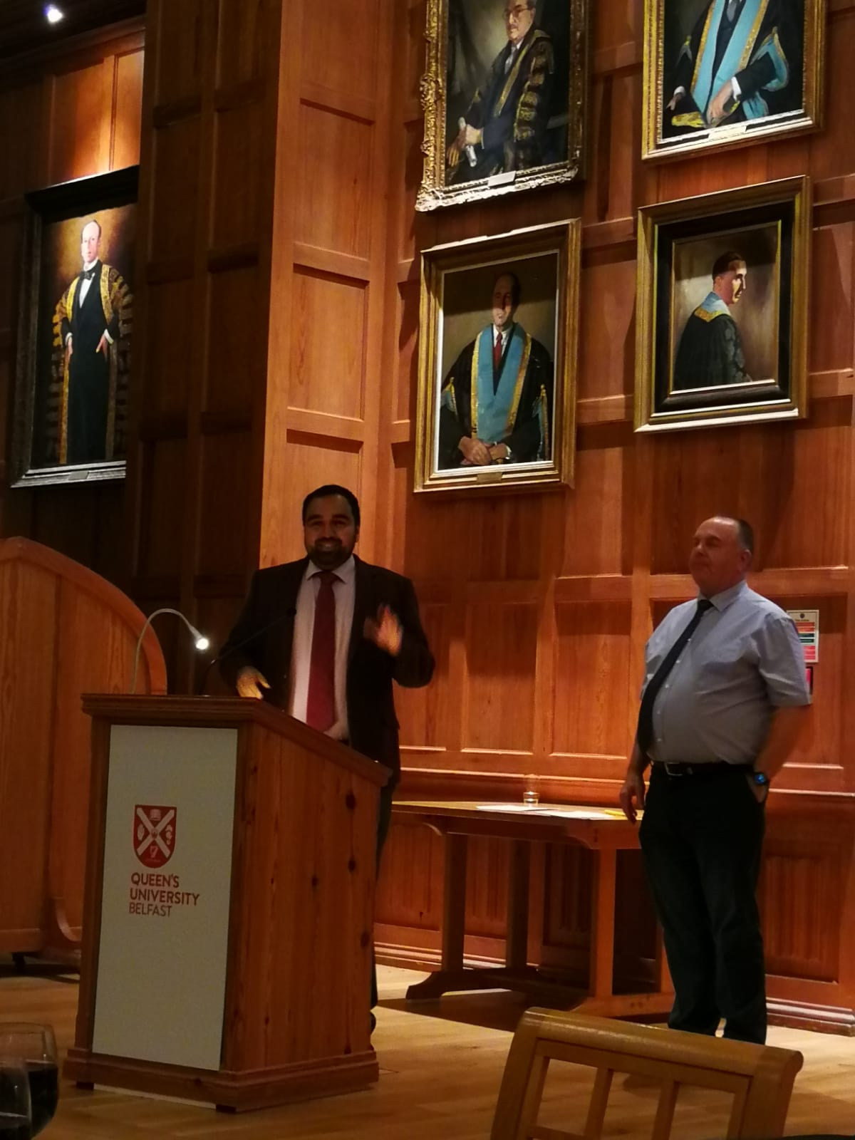
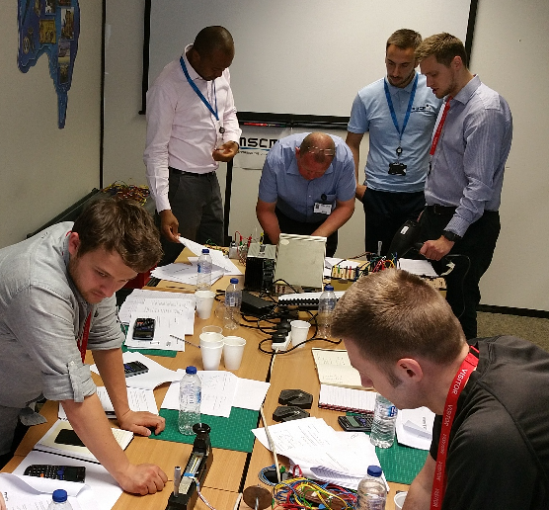
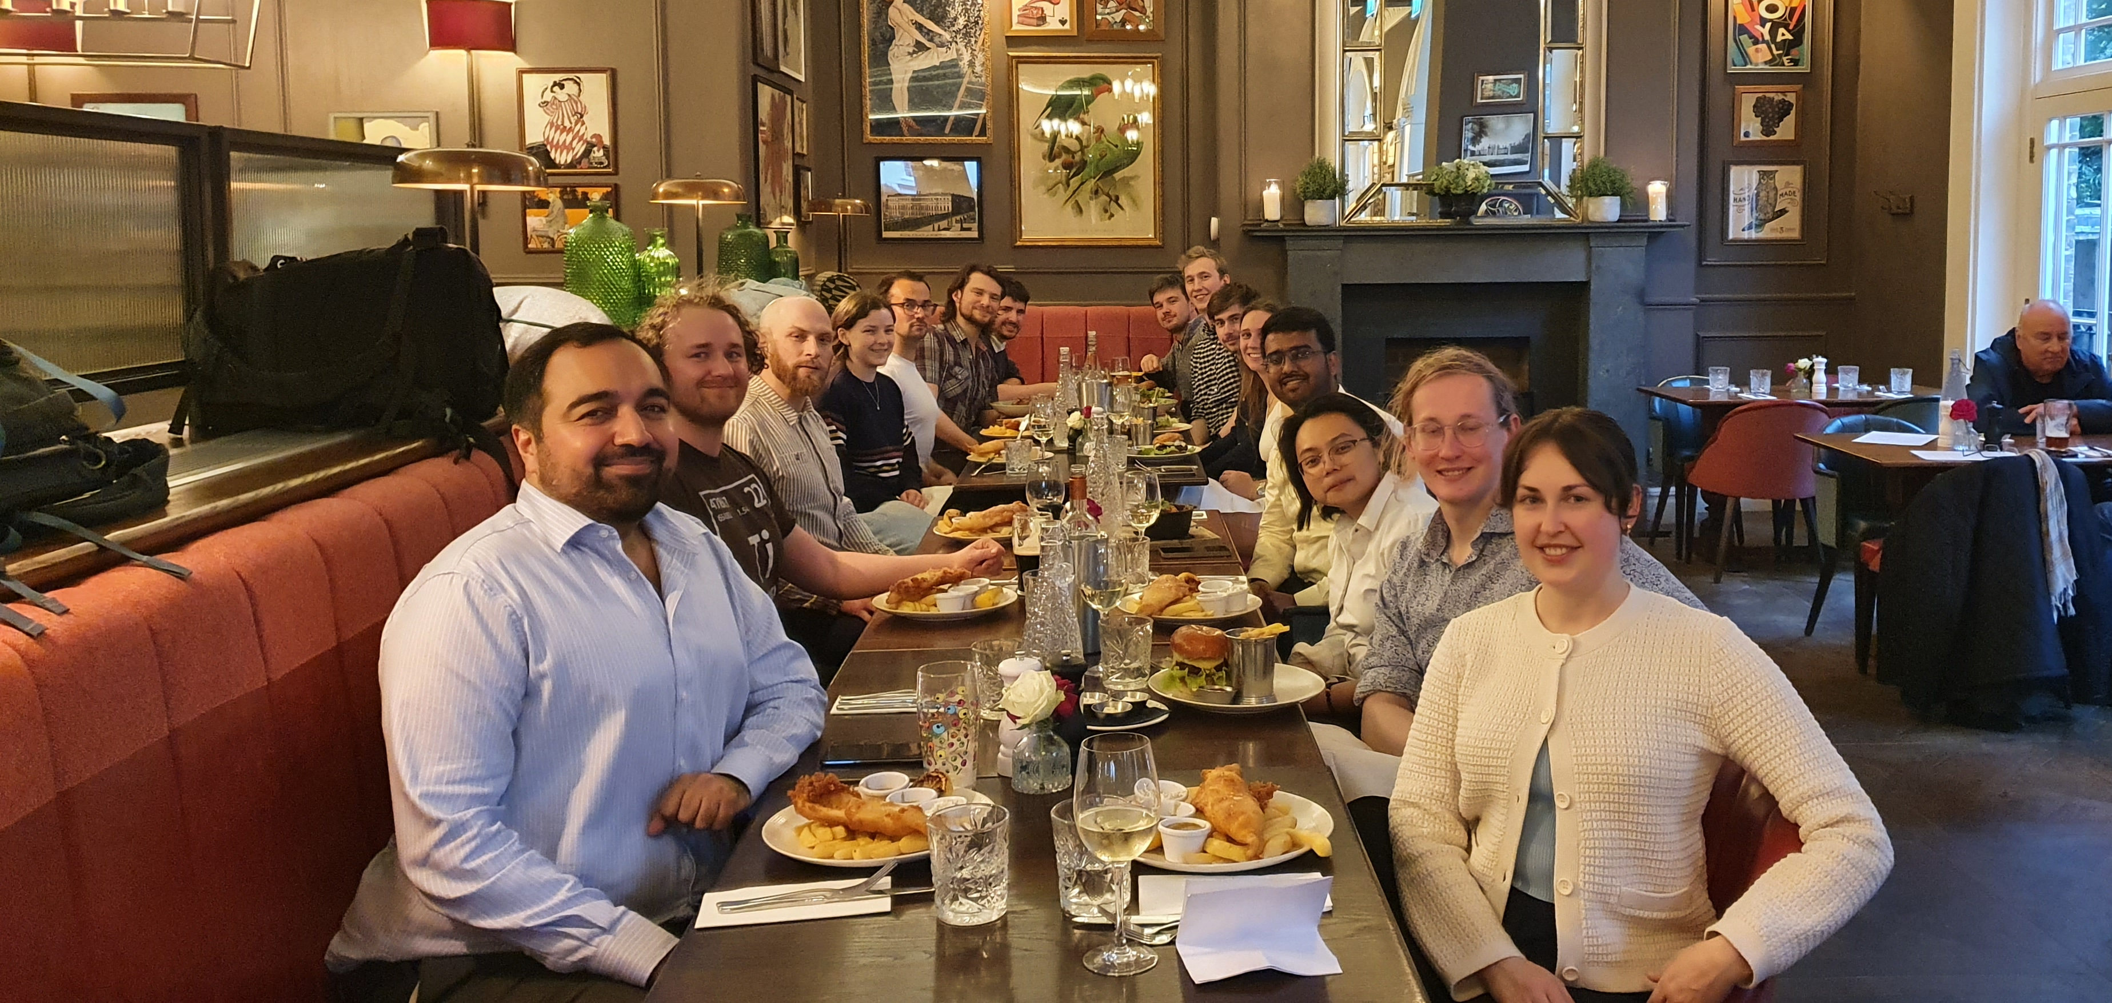
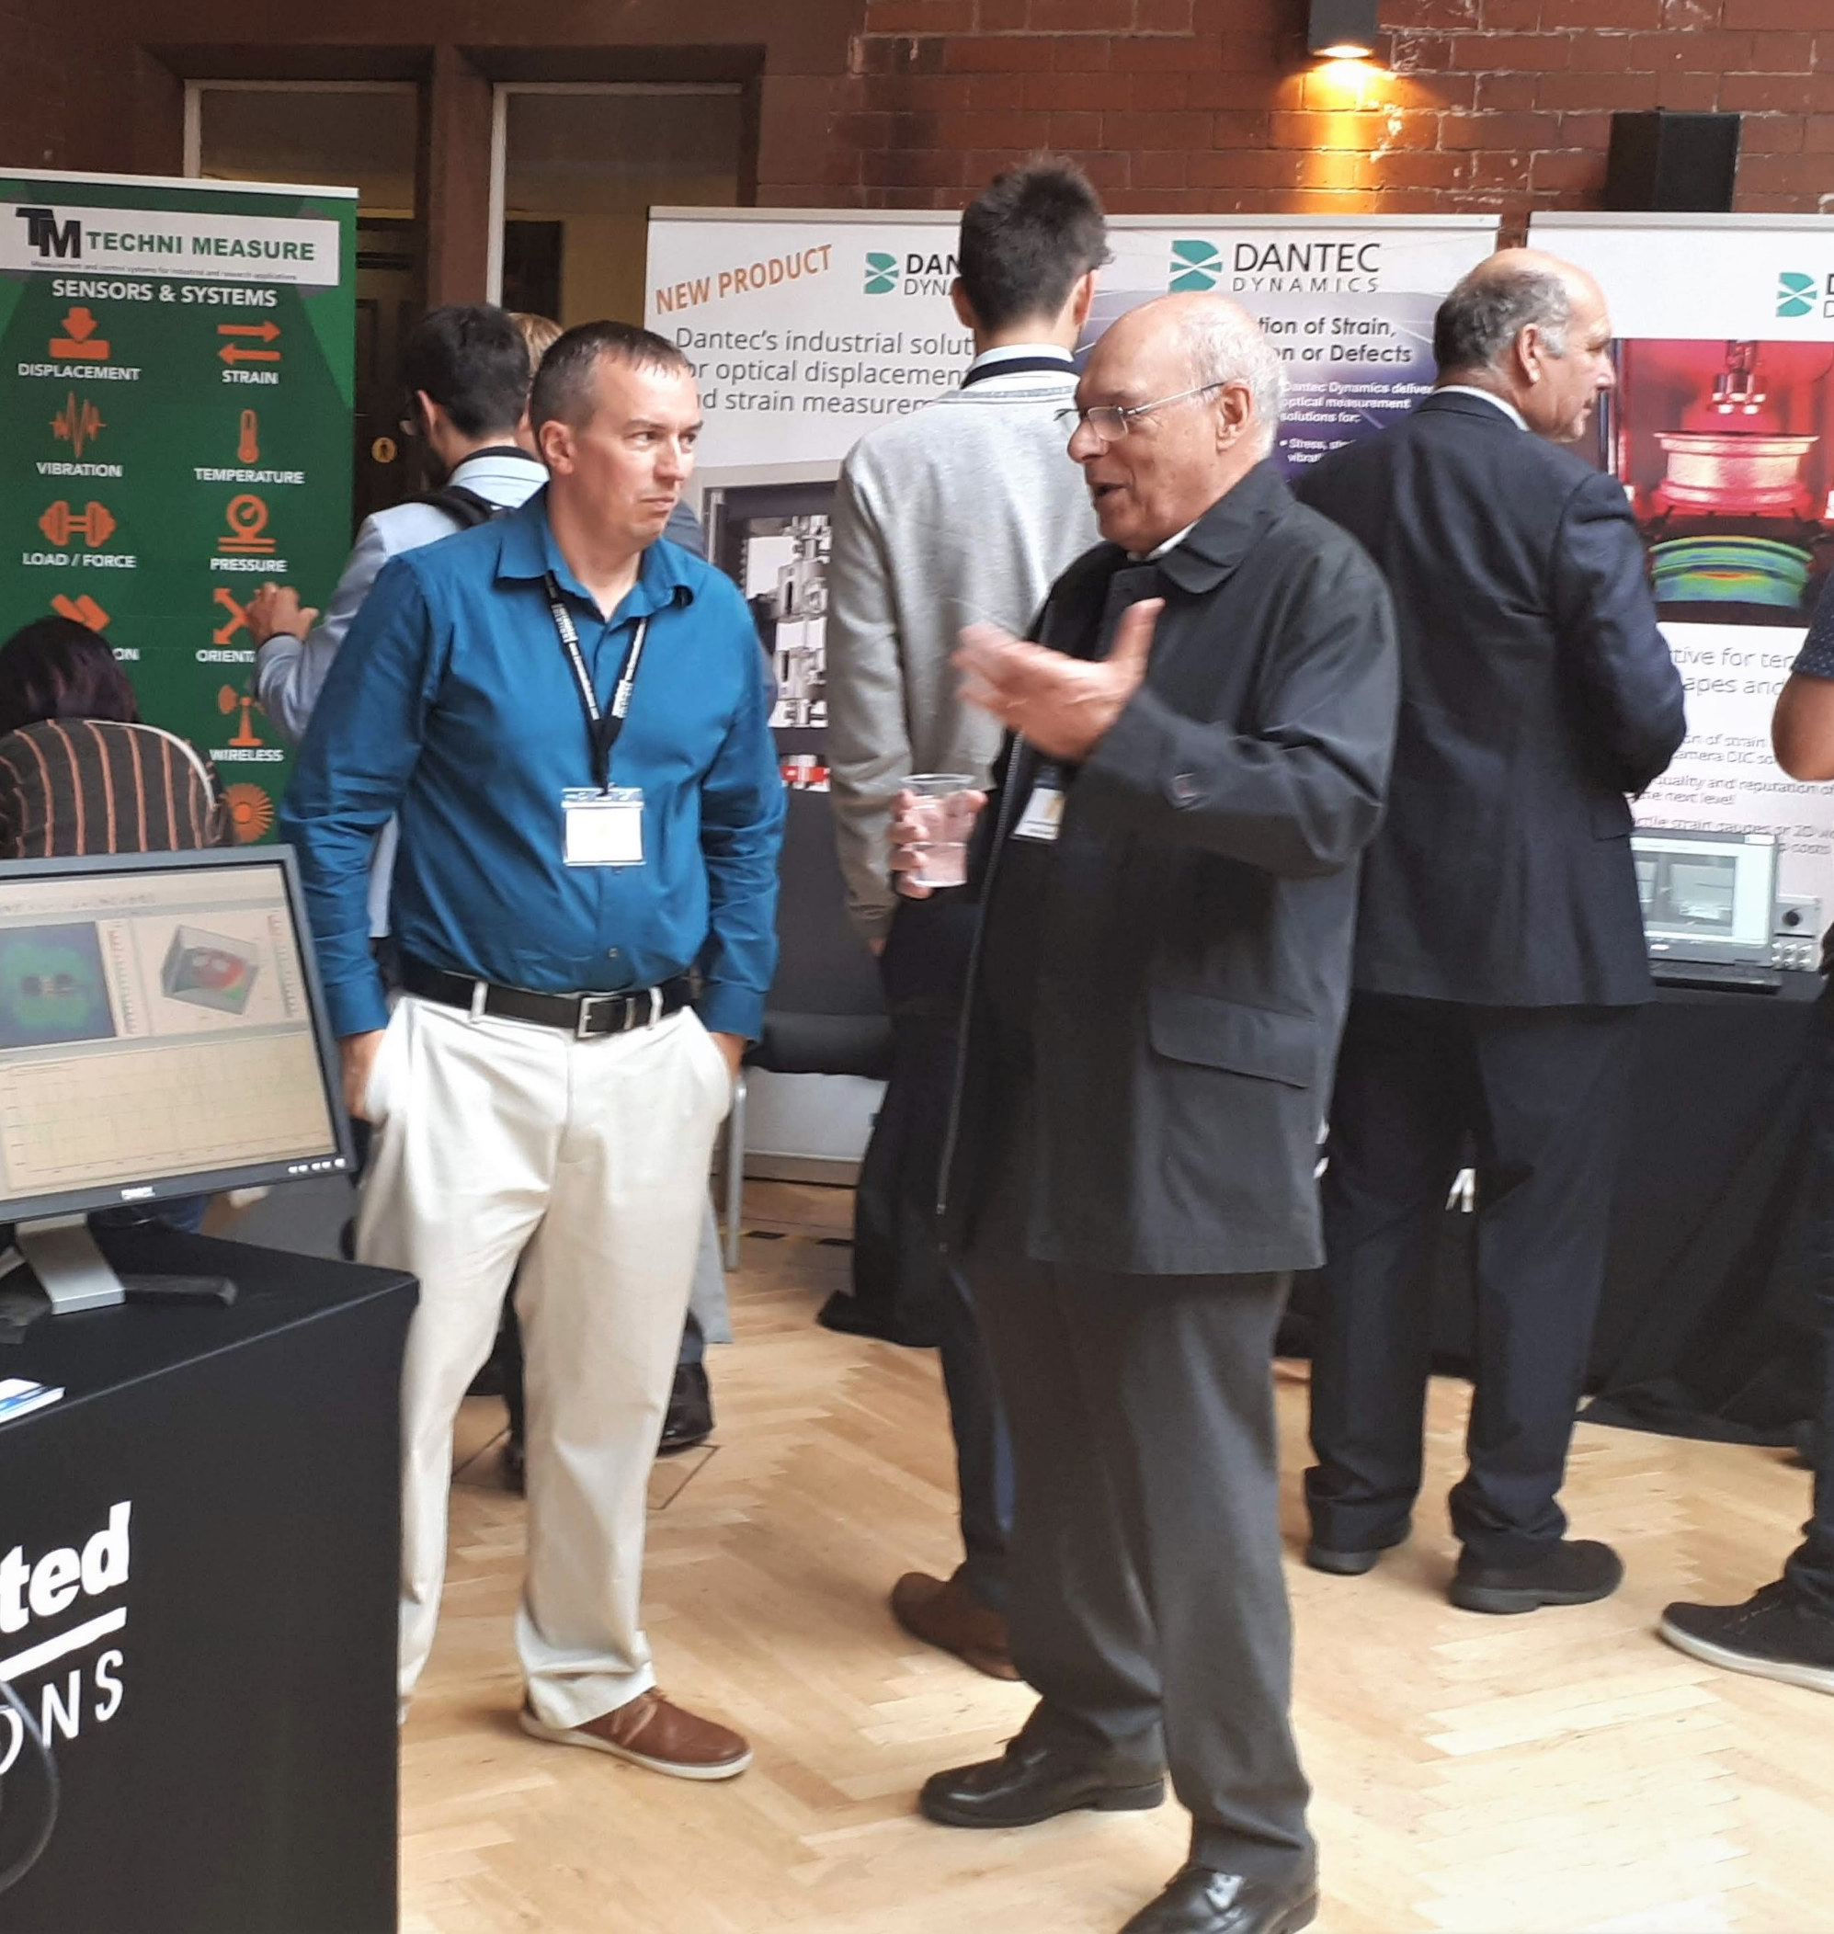
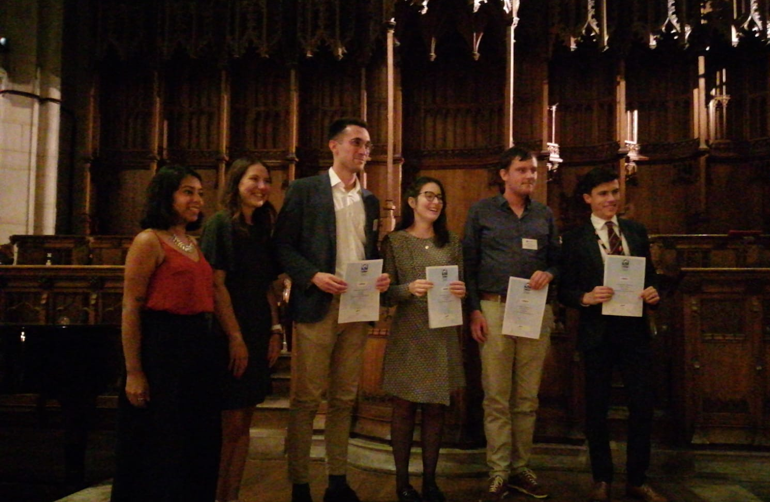
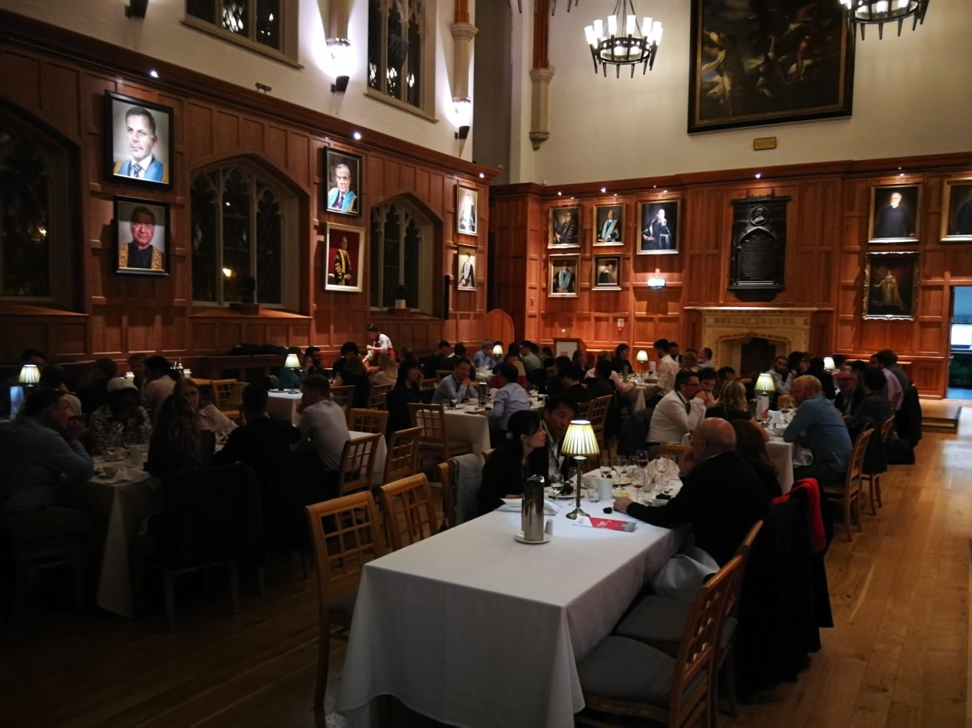
BSSM’s Evolution
Driven by members
Inclusive and open society
Supportive of ECRs
Wealth and breadth of expertise
Driven by technological advancement
Measurement techniques
Established methods valued and help maintain context and necessary critique for innovation
Digital/virtual world fusing with the physical/real world including digital twins as well as data driven approaches
Underlining the need for high-quality measurements
Smarter testing, considerate of wider factors in engineering and scientific practice e.g. environmental

Slide 9
60th Anniversary Showcase
Challenges of Strain Measurements in Industry
P. Richardson & L. Harris (Airbus)
X-Ray Tomography
I. Sinclair (Southampton)
Digital Image Correlation
P. Lava (MatchID)
Thermoelastic Stress Analysis
J. Barton (Bristol)
Photoelasticity
R. Thomlinson & W. Fraser (Sheffield)
Strain Gauges
Ian Jones (CerCo Chair)
Virtual Fields
Fabrice Pierron (MatchID)
Tour Sessions and Exhibition throughout the day

